Slide 1
Understanding Classes & Objects in JS
A Class – A Template for Objects
function Car {
this.color= 233;
this.xpos = 23;
Car() {
c=color(255);
xpos= width/2;
}
this.display(){
fill(color);
rect(xpos,100,100,100)
}
this.drive(){
xpos=xpos+1;
}
}
var myCar;
void setup(){
myCar = new Car();
}
void draw(){
background(255);
myCar.drive();
myCar.display()
}
The Class Name
Declares an Object
The Data
Initialize Object
No Constructor in JS
Call functions on Object
The Functionality
Class Names are normall capitalised.

Slide 2
Understanding Classes & Objects
A Class – A Template for Objects
function Car {
this.color= 233;
this.xpos = 23;
this.display(){
fill(color);
rect(xpos,100,100,100)
}
this.drive(){
xpos=xpos+1;
}
}
var myCar;
void setup(){
myCar = new Car();
}
void draw(){
background(255);
myCar.drive();
myCar.display()
}
myCar
Makes a Car Object
named myCar
color=255;
xpos= 23;
display(){
fill(255);
rect(23,100,100,100)
}
void drive(){
xpos=xpos+1;
}

Slide 3
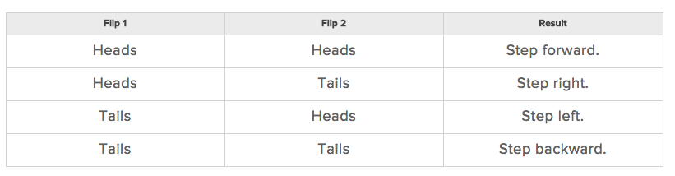
Randomness…& the Random Walker
http://natureofcode.com/book/introduction
Balance Beam Randomness
Every 10 seconds flip a coin
Heads – Step forward
Tails – Step Backwards
Understand object oriented programming
How do we define rules that govern the behaviuour of our objects
How do we implement these rules in P5
We nedd a basic understanding of Randomness, Probablility and Perlin Noise
Lets begin by defining the Walker class – what it means to be a walker object
Basic option with 2 outcomes
More Sophisticated with 4 option

Slide 4
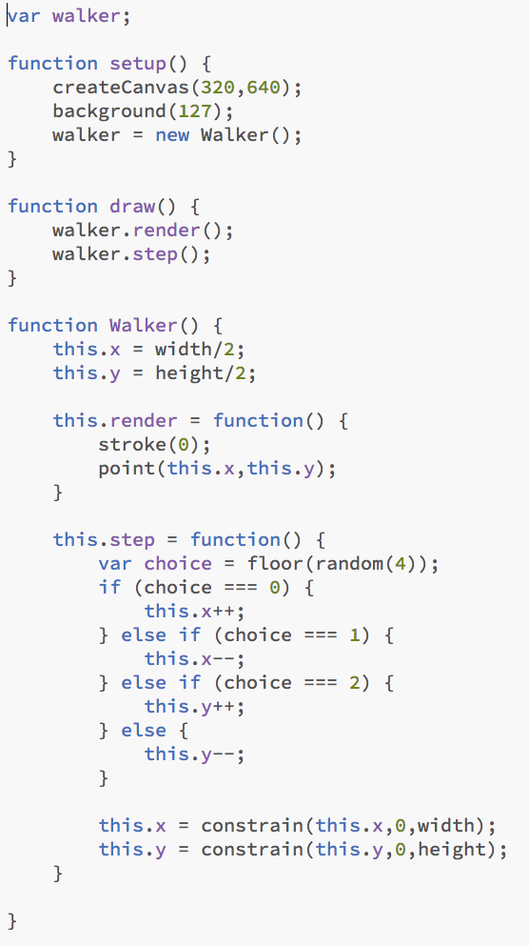
Randomness…& the Random Walker
Declare a walker object
P5.js has 2 main functions setup() and draw(). Setup() happens only at the start and draw() occurs every frame.
In this instance we create a canvas sized 320 x 640 and make its background 127 in color (grey)
Here we tell it what type of object walker is and we then call the Walker class to make a walker object
On each frame the draw() function is called. It in turns calls the walker render() function from inside the walker object
It then calls the steps function from inside the walker object
This is the Walker class that makes walker objects. All variable declarations and function are preceded with this.
This is one approach of randomness. We will try others soon
Floor(random(4)) will choose a random float between 0 & 4 (max 3.9999). It then floors it (by removing the decimal places). The max will be 3 and the min 0. Using this result we give it 4 outcomes using an if statement.
We don’t want our point to go off the screen so we use a p5.js function called constrain to limit its x position. (constrain a value between 2 other values)
sketch01.js

Slide 5
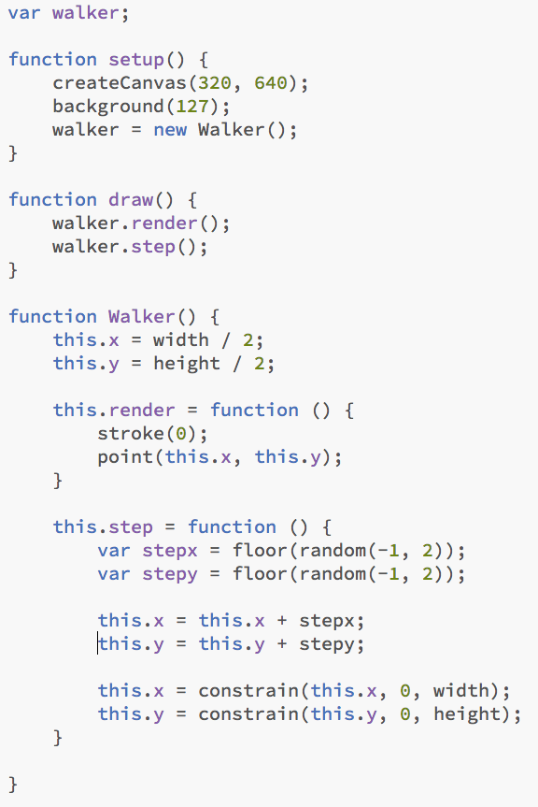
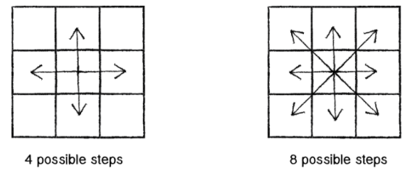
Randomness…& the Random Walker
Nothing has changed up to here
Here we break the steps into x and y directions. We ask for a random number between -1 and 2 and we then floor it. 1.9 will be floored to 1, 0.9 will be floored to 0 and -0.2 will be floored to -1. This is one way to achieve 9 outcomes including not moving
All of these variations on the “traditional” random walk have one thing in common: at any moment in time, the probability that the Walker will take a step in a given direction is equal to the probability that the Walker will take a step in any direction. In other words, if there are four possible steps, there is a 1 in 4 (or 25%) chance the Walker will take any given step. With nine possible steps, it’s a 1 in 9 (or 11.1%) chance.
Sketch02.js

Slide 6
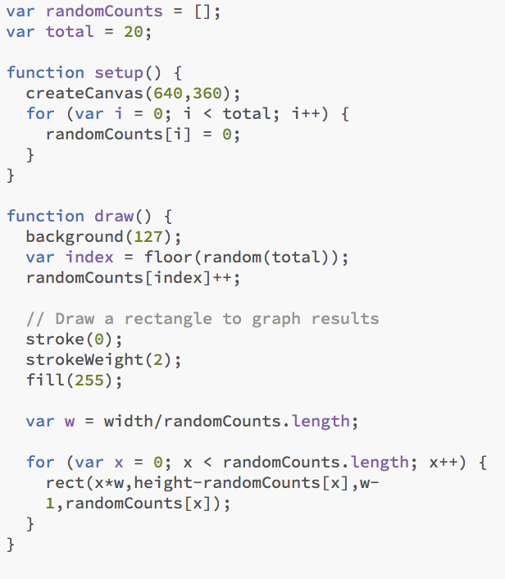
Uniform Distribution of Numbers (pseudo Random)
Lets prove that the random() produces just that
Firstly we declare and empty array called randomCounts and a variable for the number of items we will have in our array.
In our setup we create a canvas. The loop populates the array with zero’s
[0,0,0,0,0,0,0,0,0,0,0,0,0,0,0,0,0]
So now everytime we draw (or the draw loop occurs each frame) we redraw the background (see what would happen if you didn’t do this)
We then choose a random number between 0 and 20, floor it (so the results will be 0 – 19 integers) and we add it to the value in the array.
Example 6.76 randomly choosen –
floored to 6 – randomCounts[6] = 0 + 1 = 1
[0,0,0,0,0,0,1,0,0,0,0,0,0,0,0,0,0]
Black stroke with weight of 2px and fill of White selected and ready to be used to draw something
Calculates the width of each bar
Loops 20 times (once for each bar) and creates a rectangle with a height based on the array value at the time. Rect(x Start Pos, y Start Pos, width, Height)
Sketch03.js
Remember objects are drawn on the screen based on the x,y location. (0,0) is based at the top left corner. X is positive to the right and y is positive going downwards.

Slide 7
Probability & Non Uniform Distributions
Probability Basic Principles
If you have a system with a certain number of possible outcomes, the probability of the occurrence of a given event equals the number of outcomes that qualify as that event divided by the total number of all possible outcomes.
Coin toss simple example ½ = 50% probability
The Card Deck Problem
Take a deck of fifty-two cards. The probability of drawing an ace from that deck is?
number of aces / number of cards = 4 / 52 = 0.077 = ~ 8%
The probability of drawing a diamond is?
number of diamonds / number of cards =
13 / 52 = 0.25 = 25%
Probability of multiple events occurring in sequence
To do this, we simply multiply the individual probabilities of each event.
The probability of a coin turning up heads three times in a row is?
(1/2) * (1/2) * (1/2) = 1/8 or 0.125 = 12.5%

Slide 8
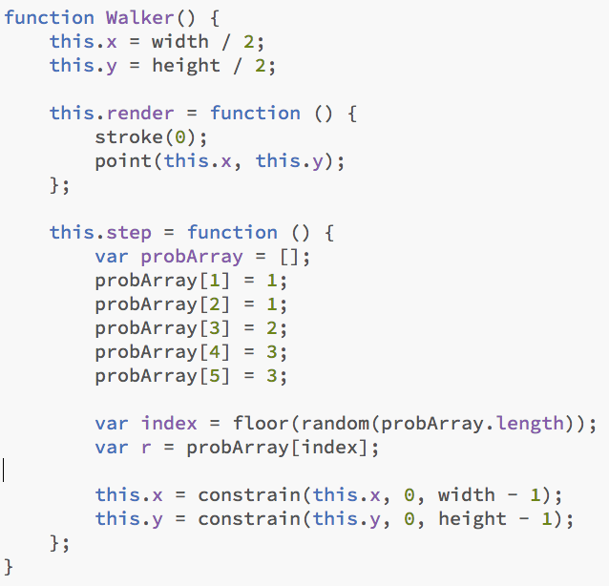
Probability & Non Uniform Distributions
Implementing probability with the random()
This is one way of doing it
In this instance r (our random number) has 40% of being a 1 or a 3 and 20% chance of being a 2
Sketc04.js
Sketch02.js

Slide 9
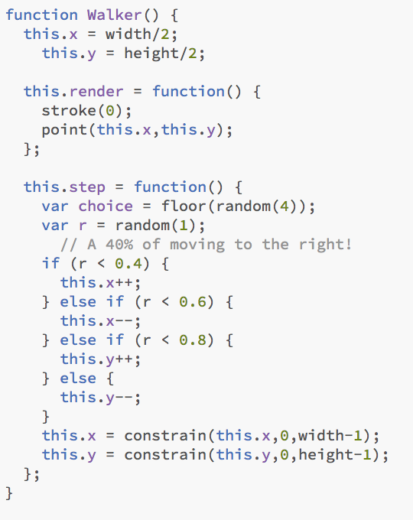
Probability & Non Uniform Distributions
Implementing probability with the random()
This is another way of doing it
In this instance r (our random number) is a floating number between 0 and 1. It has a 40% chance of moving to the right, a 20% chance of moving down and so on.
Sketch05.js

Slide 10
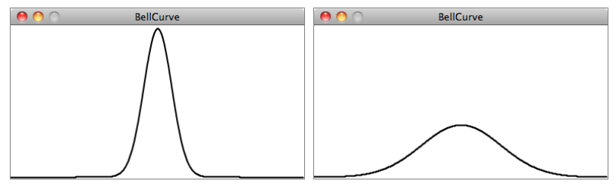
Normal/Gaussian Distribution
The height of Monkeys?
The mean is pretty easy to understand. In the case of our height values between 200 and 300, you probably have an intuitive sense of the mean (i.e. average) as 250. However, what if I were to say that the standard deviation is 3 or 15? What does this mean for the numbers?
The graphs above should give us a hint. The graph on the left shows us the distribution with a very low standard deviation, where the majority of the values cluster closely around the mean. The graph on the right shows us a higher standard deviation, where the values are more evenly spread out from the average.
Given a population, 68% of the members of that population will have values in the range of one standard deviation from the mean, 98% within two standard deviations, and 99.7% within three standard deviations.
A distribution of values that cluster around an average (referred to as the “mean”) is known as a “normal” distribution. It is also called the Gaussian distribution (named for mathematician Carl Friedrich Gauss)

Slide 11
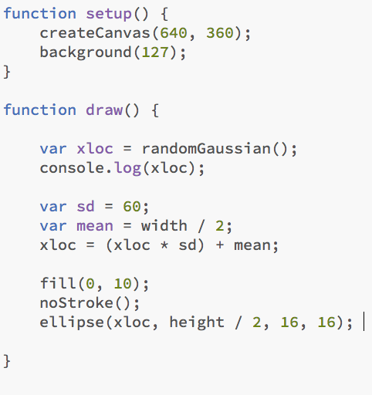
Normal/Gaussian Distribution
Standard Deviation in action
Get a gaussian random number w/ mean of 0 and standard deviation of 1.0
Define a standard deviation
Define a mean value (middle of the screen along the x-axis)
Scale the gaussian random number by standard deviation and mean
Draw an ellipse at our "normal" random position
Sketch06.js

Slide 12
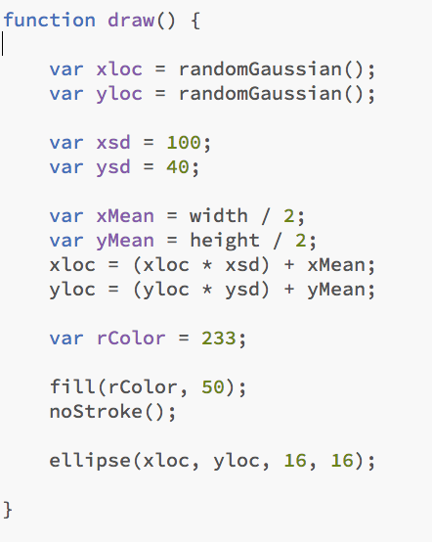
Normal/Gaussian Distribution
Standard Deviation in action – 2 Dimensions
Get a gaussian random number w/ mean of 0 and standard deviation of 1.0
Define a standard deviation
Define a mean value (middle of the screen along the x-axis)
Scale the gaussian random number by standard deviation and mean
Draw an ellipse at our "normal" random position
Sketch07.js

Slide 13
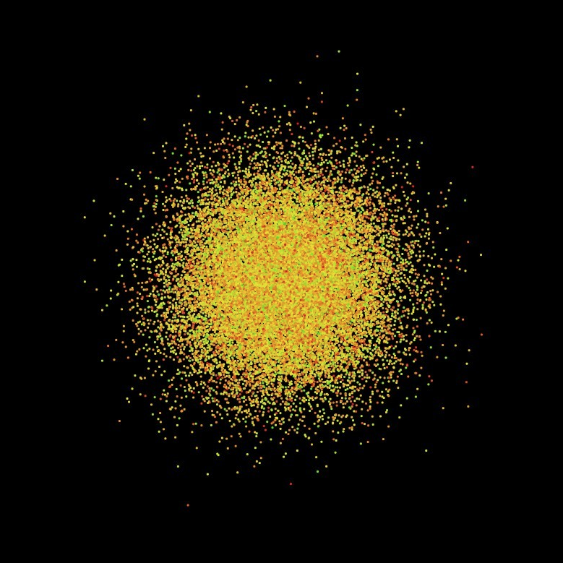
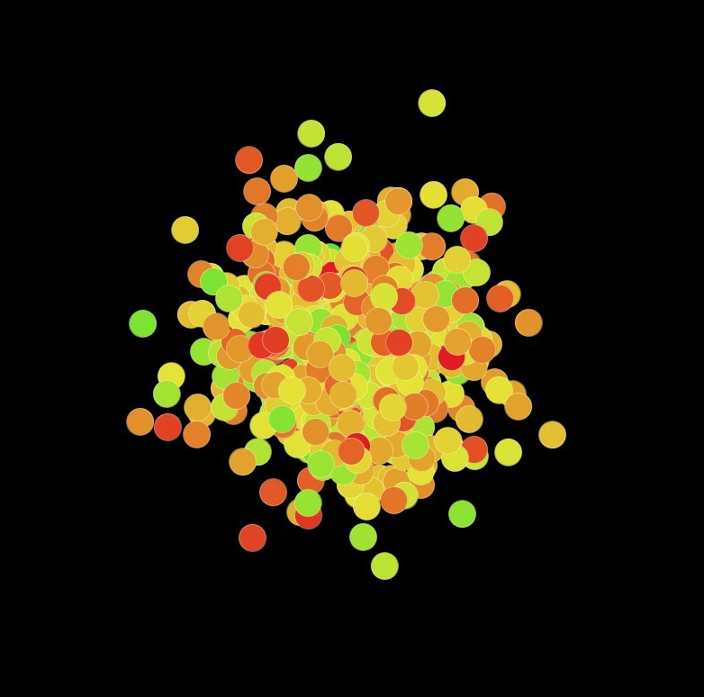
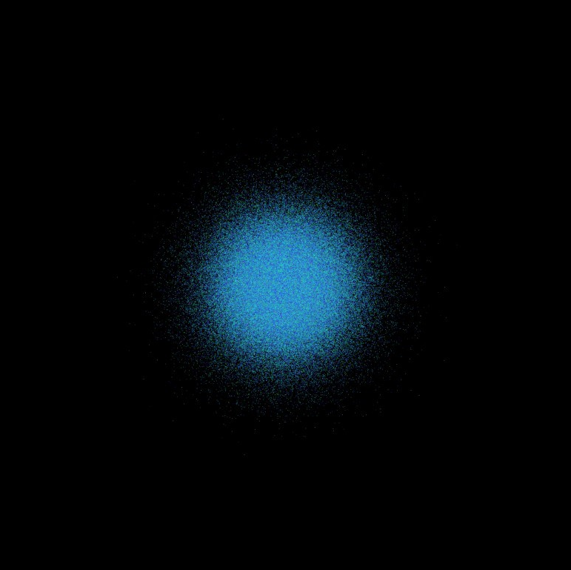

Slide 14
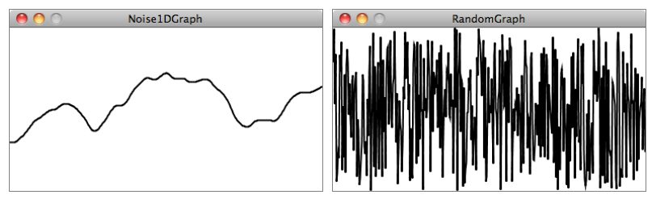
Perlin Noise (A Smooth Approach)
However, randomness as the single guiding principle is not necessarily natural. An algorithm known as “Perlin noise,” named for its inventor Ken Perlin, takes this concept into account. Perlin developed the noise function while working on the original Tron movie in the early 1980s; it was designed to create procedural textures for computer-generated effects.
Perlin noise has a more organic appearance because it produces a naturally ordered (“smooth”) sequence of pseudo-random numbers. The graph on the left below shows Perlin noise over time, with the x-axis representing time; note the smoothness of the curve. The graph on the right shows pure random numbers over time.
While the arguments to the random() function specify a range of values between a minimum and a maximum, noise() does not work this way. Instead, the output range is fixed—it always returns a value between 0 and 1. We’ll see in a moment that we can get around this easily with Processing’s map() function, but first we must examine what exactly noise() expects us to pass in as an argument.

Slide 15
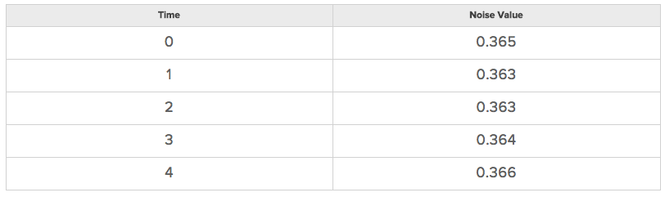
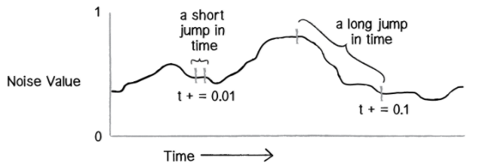
Perlin Noise (A Smooth Approach)
We can think of one-dimensional Perlin noise as a linear sequence of values over time.
var n = noise(3);
According to the above table, noise(3) will return 0.364 at time equals 3. We could improve this by using a variable for time and asking for a noise value continuously in draw().
var t = 0;
function draw() {
var n = noise(t);
//Now, we move forward in time!
t += 0.01;
}
How quickly we increment t also affects the smoothness of the noise. If we make large jumps in time, then we are skipping ahead and the values will be more random.

Slide 16
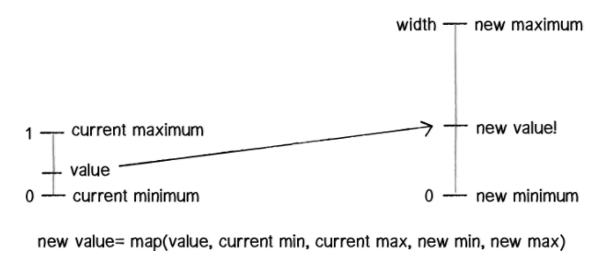
Mapping Noise
The map() function takes five arguments. First up is the value we want to map, in this case n. Then we have to give it the value’s current range (minimum and maximum), followed by our desired range.
var x = map(noiseT,0,1,0,width);
In this case, we know that noise has a range between 0 and 1, but we’d like to draw our circle with a range between 0 and the window’s width.
If we need to keep track of two time variables, one for the x-location of the Walker object and one for the y-location. But there is something a bit odd about these variables. Why does tx start at 0 and ty at 10,000? While these numbers are arbitrary choices, we have very specifically initialized our two time variables with different values. This is because the noise function is deterministic: it gives you the same result for a specific time t each and every time. If we asked for the noise value at the same time t for both x and y, then x and y would always be equal, meaning that the Walker object would only move along a diagonal.

Slide 17
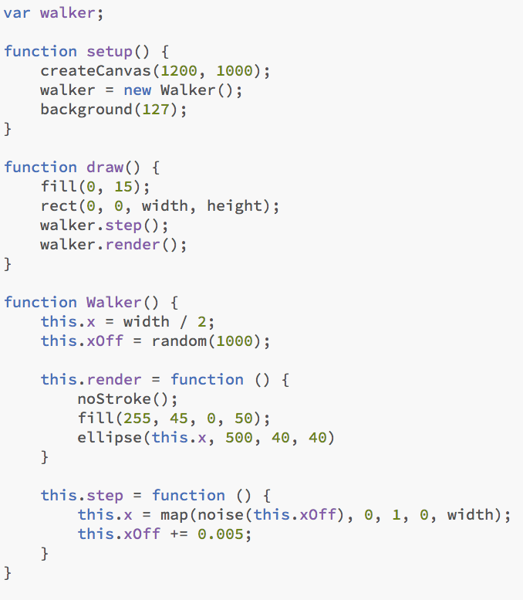
One Dimensional Noise
Nothing New
The draw loop draws a black rectangle with 15% opacity every frame. This creates the trail effect.
The x position starts in the middle of the canvas. The xOff is a random number between 0 and 1000. This the represent the time. If we call the noise function on this value it will return a value between 0 and 1. If we increment time we will get a value similar but not the same (depending on the increment amount)
The render() selects a no stroke pen with a fill at 50% opacity. It then draws an ellipse with this pen.
This function get a noise value for the current moment in time (xOff) and maps it to between 0 and the width. We then increment time(xOff)
Sketch08.js

Slide 18
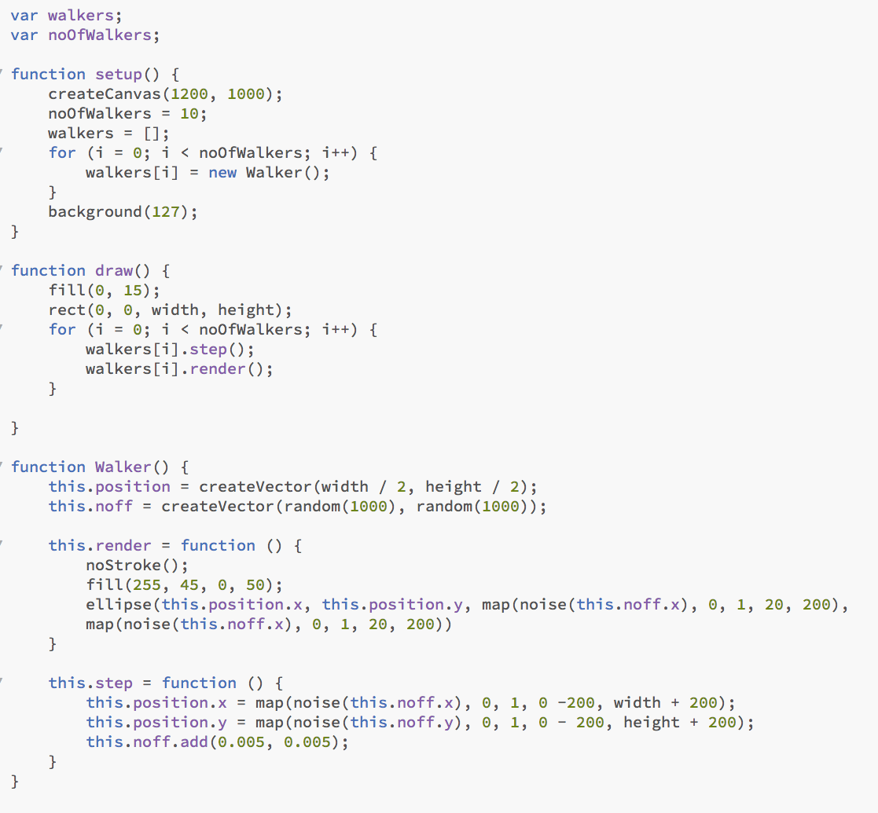
One Dimensional Noise – Fancy Pants!!
We will be discussing vectors in more detail later but for the moment consider it a way to store 2 values in a variable. Instead of having positionX and positionY we can store it as a vector variable and access it position.x or position.y
This is also to do with vectors. You can add to them very easily. TBD
Sketch09.js

Slide 19
Understanding the Pixel Array in P5
5 Pixels Wide
0 1 2 3 4
The Pixel Array
{ R(0) , G(0), B(0), A(0), R(1), G(1), B(1), A(1), R(2)…............}
To locate the Red value of this pixel in the Pixel Array we multiply the Y value by width, add the X value and multiply by 4
0 1 2 3 4 5
6 Pixels High
(X + Y * Width) * 4
(2 + 2 * 5) * 4 = 48
Therefore index[48] of the pixel array will be the red value of this pixel. We can then easily find the Green, Blue and Opacity value because they are neighboring it.
loadPixels();
var index= (2+2*5)*4
pixels[index+0] = 255;
pixels[index+1] = 0;
pixels[index+2] = 0;
pixels[index+3] = 255;
updatePixels();
Sketch10.js
So now we need to create a nested loop which will run through all the Y values. For each Y value we need to run a loop for each X value.

Slide 20
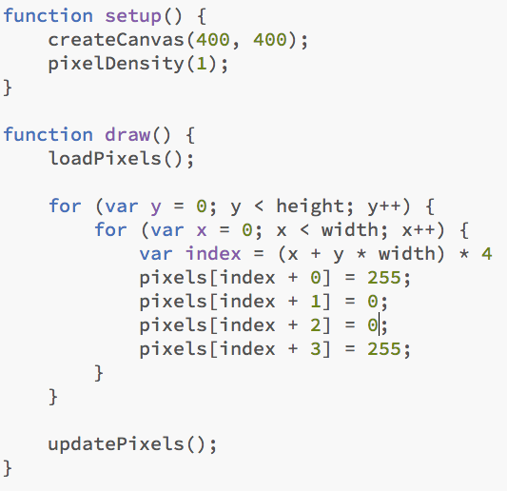
Understanding the Pixel Array in P5
We need to set pixelDensity to 1. This is to manage HD and Retina Display issues
Start with the loadPixels function
Start looping through each Y value
For each Y value start looping through each X value
Calculate the Index by our magic formula
Then change each array value
Finish with the updatePixels function
Sketch11.js

Slide 21
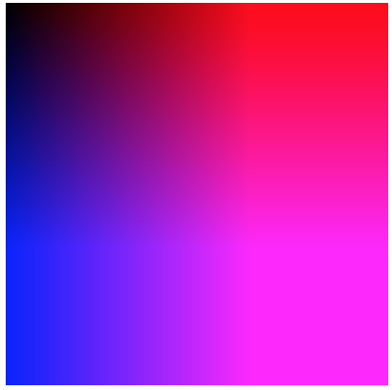
Understanding the Pixel Array in P5
Change these values to x,0,y,255 for this effect
Sketch12.js

Slide 22
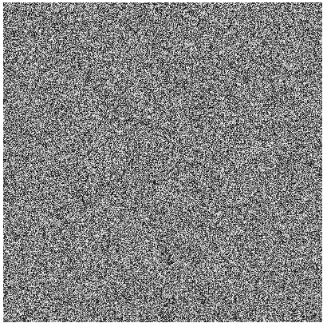
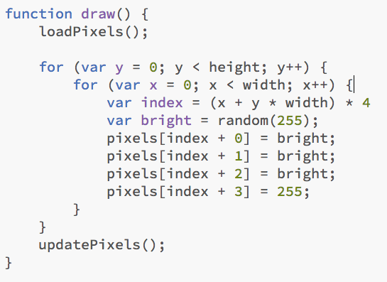
Understanding the Pixel Array in P5
Add a bit of randomness to the situation
Sketch13.js

Slide 23
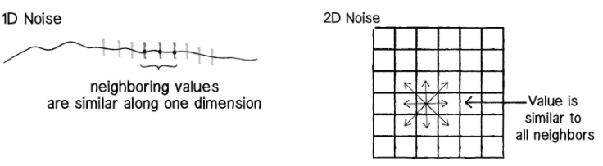
2D Noise
xOff =100
Noise(xOff) will return a value between 0 & 1
Lets say 0.0235
If we increment xOff
xOff = xOff + 1
Noise(xOff) will now return a value of 0.0237
Very similar numbers
xOff = 100
yOff = 50
Noise(xOff,yOff) will return 2 values between 0 & 1
Lets say (0.0235,0.387)
If we increment xOff and yOff
xOff = xOff + 1
yOff = yOff + 1
Noise(xOff,yOff) will now return 2 values of (0.0237,0.384)
Very similar numbers

Slide 24
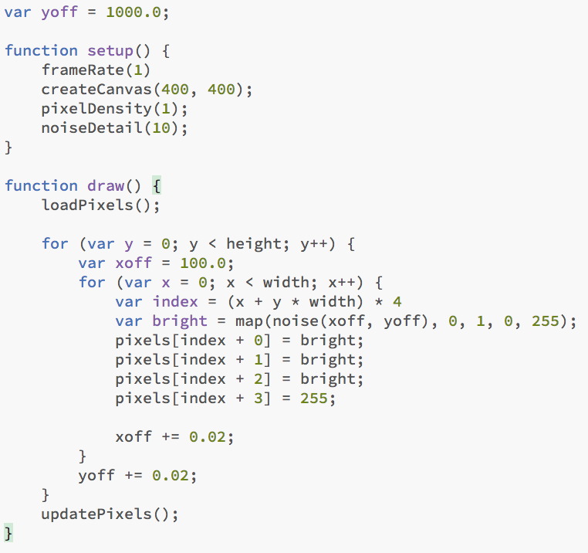
Implementing 2D Noise in the Pixel Array
A smoother approach
Remember this value is an arbituary moment in time offset by an amount
Now we get a noise value for that arbituary moment in time and we map it to a value
We increment the xoff value. The smaller the number the smoother the difference between the values
Sketch14.js

